Slide 1


Insurance Corporation of British Columbia
DATA VISUALIZATION – TERM PROJECT
Insights from Reported Crashes in Metro Vancouver for 2018 - 2022: A Visual Analysis Using Tableau
By: Jose Cornelio

Slide 2
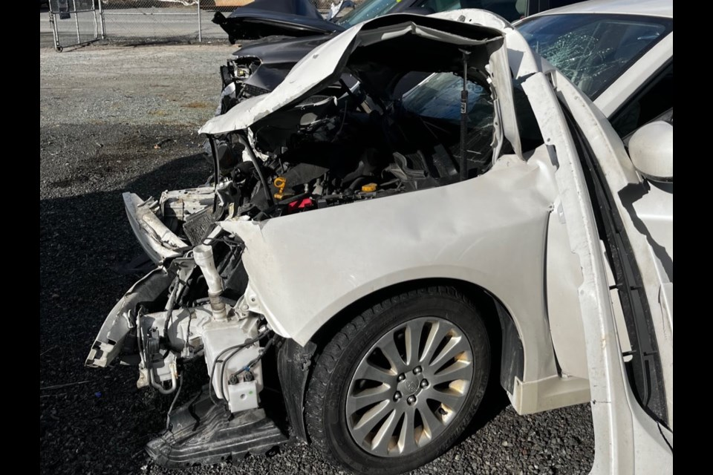

Overview
Introduction
01
Dataset Overview
02
Analysis Questions
03
Data Preparation
04
Exploratory Data Analysis
05
Conclusion
06
References
07

Slide 3
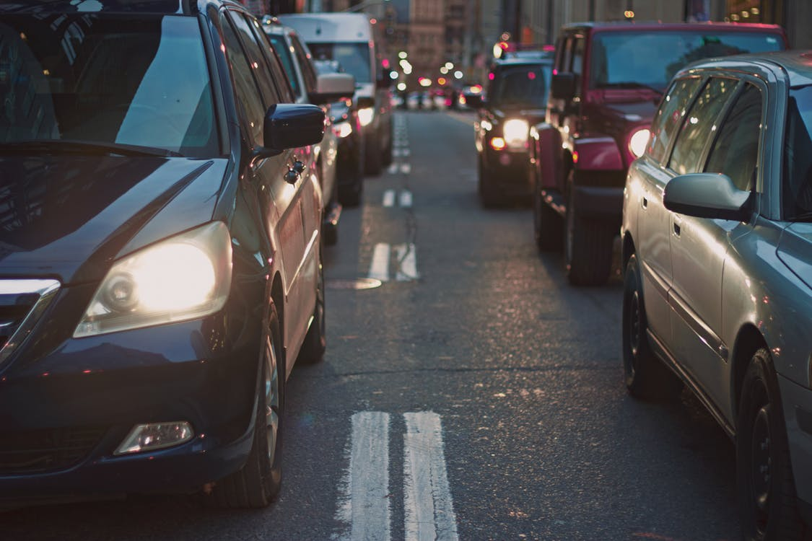
Introduction
This project delves into the dynamics of vehicular crashes in Metro Vancouver spanning 2018 to 2022, leveraging data from ICBC Reported Crashes and the British Columbia Population. Through Tableau's visualization tools, the analysis aims to unearth trends, patterns, and risk factors essential for evidence-based strategies to enhance road safety outcomes. The structured approach encompasses data cleaning, variable identification, and nine key analysis questions addressing crash time series, geospatial patterns, correlation with population data, crash rates per capita, types of crashes, severity analysis, vehicle and victim profiles, street analysis, and forecast projections. Ultimately, the project endeavors to offer actionable insights crucial for informed policy decisions and proactive measures in mitigating vehicular accidents in Metro Vancouver.

Slide 4
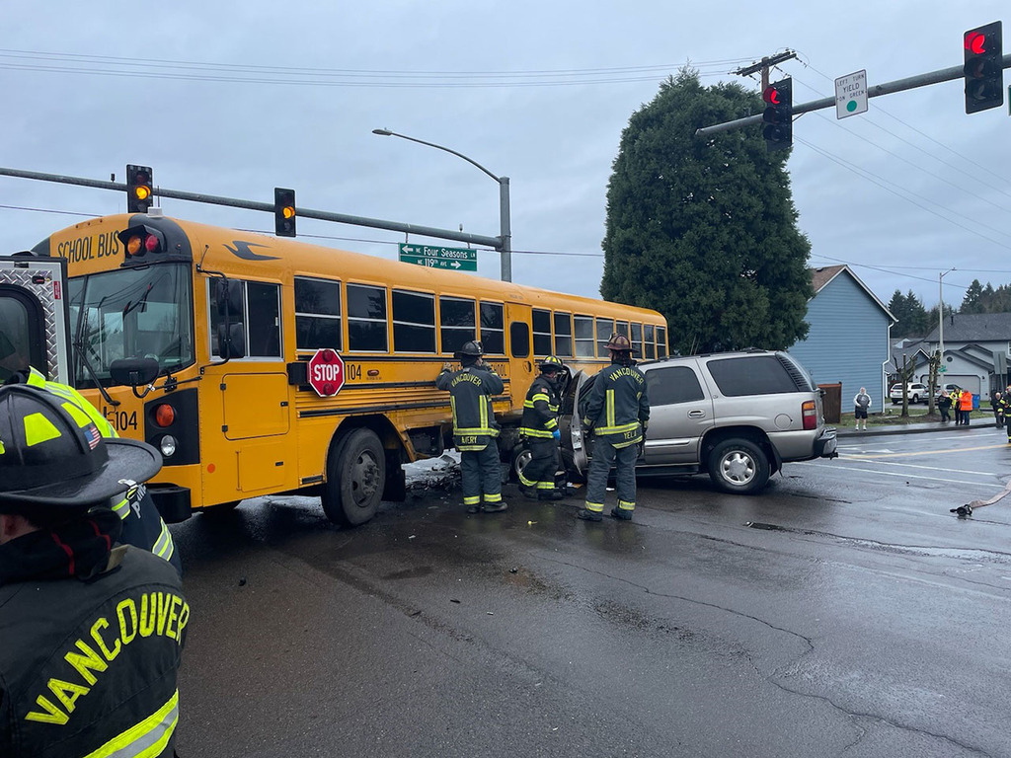
Dataset Overview
Objective: Analyze vehicular crashes in Metropolitan Vancouver from 2018 to 2022.
Data Sources: ICBC Reported Crashes and British Columbia Population datasets.
Reported Crashes: Obtained from ICBC, covers 2018-2022 for British Columbia, focusing on Metro Vancouver municipalities.
Variables: Crash Count, Crash Severity, Cross Street Full Name, Cyclist Included, Date Of Loss Year, Day Of Week, Heavy Vehicle Included, Intersection Crash, Latitude, Longitude, Month Of Year, Motorcycle Included, Municipality Name, Municipality With Boundary, Parked Vehicle Included, Pedestrian Included, Region, Road Location Description, Street Full Name, Total Victims.
Population Data: From The Official website of the Government of British Columbia, covering 2011-2023 for all BC regions, with focus on Metro Vancouver municipalities in 2018-2022.
Population Variables: Municipality Name, Population, Year.

Slide 5
Analysis Questions
The objective of this project is to answer the following questions:
Question 01
Question 02
Question 03
Question 04
iHow has the number of crashes evolved over time?
What municipalities experience the highest number of crashes?
Is there a correlation between the frequency of reported crashes and the population size of municipalities?
How do crash rates per capita differ between municipalities?
Question 05
Question 06
Question 07
Question 08
What are the most frequent types of crashes?
What is the distribution of crash severity levels?
What types of vehicles are most commonly involved in crashes?
Do crashes correlate with specific street locations?

Slide 6
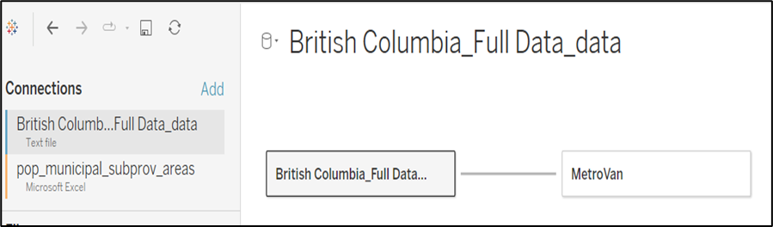
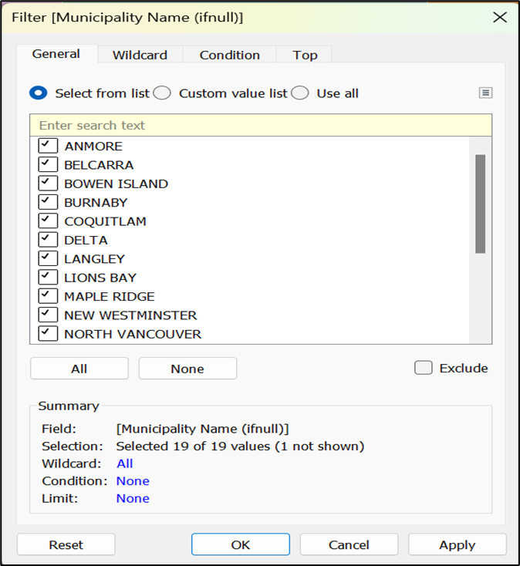

Data Preparation
Data connection
Filters
Calculated Fields
This section outlines the database preparation steps for addressing the analysis questions. The ICBC Reported Crashes database is named "British Columbia_Full Data_data.csv", while the British Columbia Population database is titled "pop_municipal_subprov_areas.xlsx" (found in the "MetroVan" sheet).
Municipality names were identified as the common key for establishing connections between the datasets.
.
We tailored our dataset to exclusively cover municipalities within Metro Vancouver. This focused approach allows for a more relevant assessment aligned with our project's goals, ensuring that our insights and conclusions directly apply to the targeted region, while excluding data from municipalities outside of Metro Vancouver.
Merged Dates:
Combines year and month columns into a single date field ('yyyy-MMM') for analysis.
Calculated Measures:
Crashes / AVG(Population) Ratio:
Computes ratio of total crashes to average population, scaled by ten.
Victim / Crashes Ratio:
Determines average number of victims per crash, offering insight into crash severity.

Slide 7


Exploratory Data Analysis
In order to answer the analysis questions of this project, here are the most relevant graphs made in Tableau and arranged in the same order that the analysis questions were formulated:

Slide 8
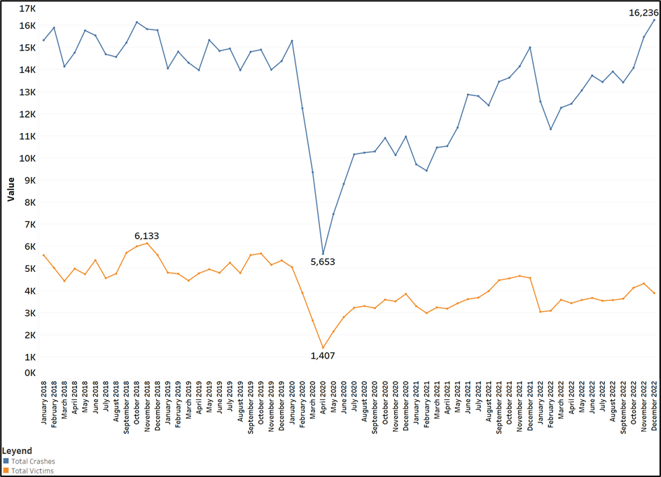
Time Series Analysis of Crashes
The double-line charDouble-line chart visualizes trends in Total Crashes and Total Victims from January 2018 to December 2022 in Metro Vancouver.
Fluctuations in these values over time are observable.
Numerical measures provide additional insights into the range and sum of total victims and crashes.
Significant decrease in accidents and victims in early 2020 attributed to COVID-19 pandemic shutdown.
Historic peak in accidents by December 2022, contrasting with steady victim numbers, hints at potential safety improvements.

Slide 9
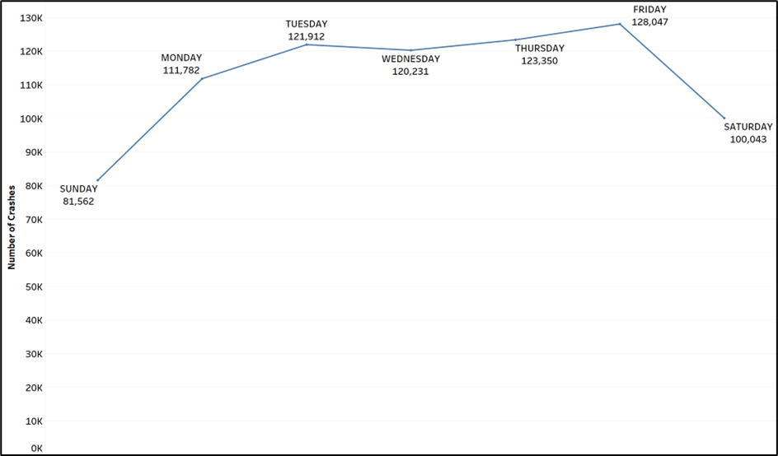
Time Series Analysis of Crashes
Line chart visualizes trends of total crashes across different days of the week.
Each line labeled with corresponding day and sum of Total Crashes.
Friday stands out with highest occurrences, totaling 12,047 crashes.
Sunday exhibits lowest crashes with 8,562 accidents.
Insights suggest Friday as a day with increased road risk, potentially due to factors like traffic volume or heightened activity levels.

Slide 10
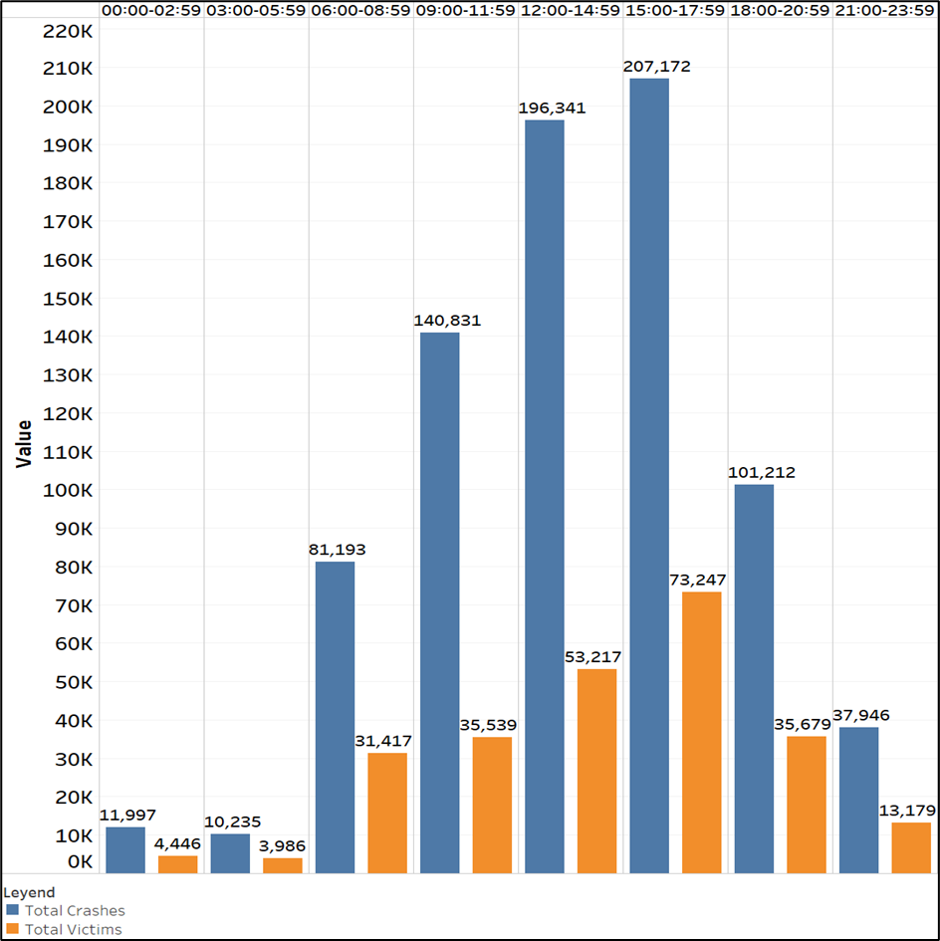
Time Series Analysis of Crashes
"Time Category" visualization uses stacked bar charts to illustrate total crashes and victims across different time intervals.
Each bar represents a specific time category, aiding in understanding crash occurrences and victim counts at different times.
Peaks during rush hours or late-night hours may indicate high-risk periods.
Comparing victim proportions to crashes offers insights into accident severity.
The 15:00-17:59 timeframe records the highest number of accidents and victims, indicating heightened risk and suggesting targeted interventions for road safety.

Slide 11
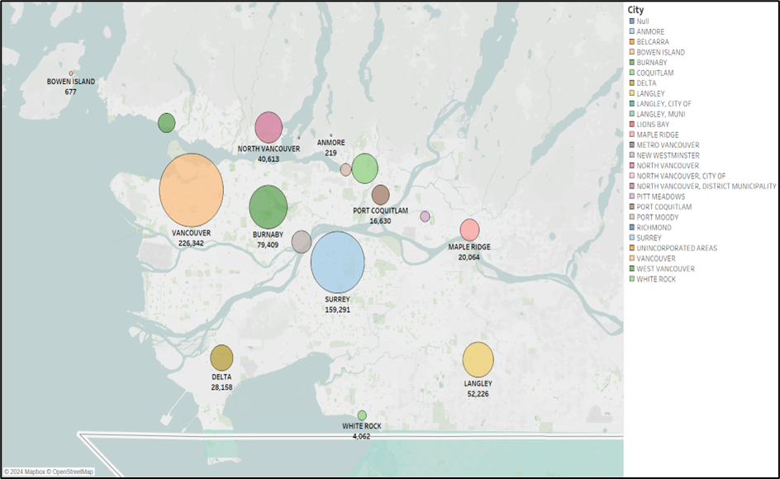
Geospatial Analysis of Crashes
Each circle on the map represents a city, with circle size indicating total crash count.
Quick visual assessment of cities experiencing higher crash frequencies.
Circles color-coded by different cities within Metro Vancouver for easy identification.
Areas with higher housing density may experience more traffic congestion, increasing accident likelihood.

Slide 12
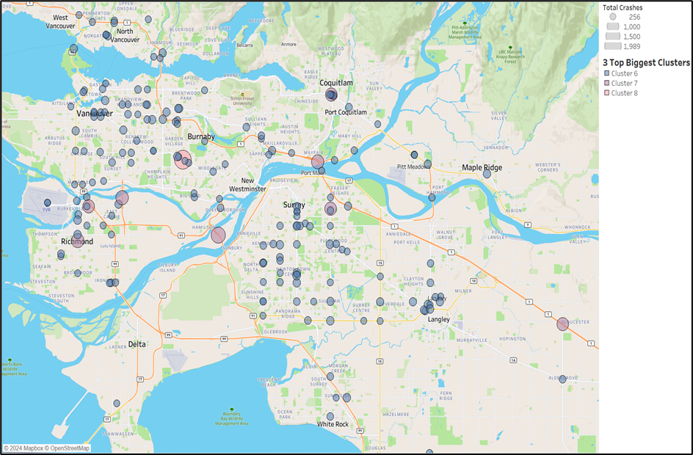
Geospatial Analysis of Crashes
Clusters offer insights into data grouping based on total crash counts, revealing varying levels of severity or frequency.
For example, Cluster 8 has the highest total crashes, indicating areas with significant accident concentration.
Conversely, Cluster 6 shows fewer total crashes, suggesting areas with lower accident rates.
Analyzing cluster characteristics aids in identifying patterns and hotspots, enabling targeted interventions for road safety improvement.

Slide 13
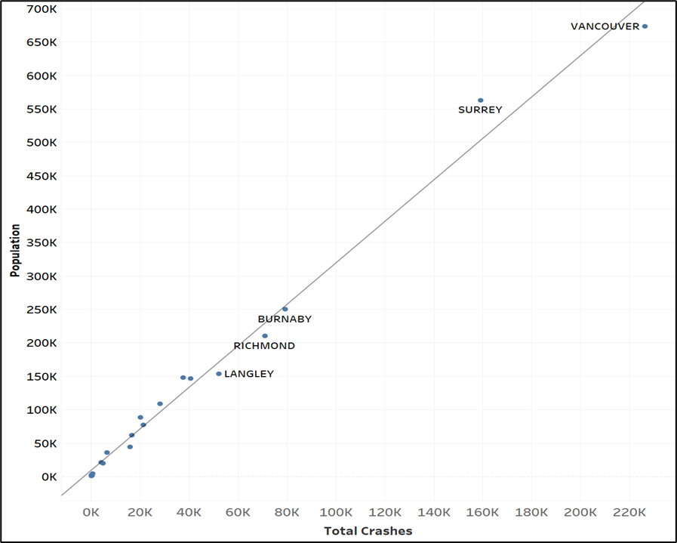
Correlation Analysis between Population and the Crashes
Scatterplot demonstrates a positive correlation between population and total crashes, suggesting higher-population municipalities tend to have more crashes.
Vancouver, with the highest population, also records the highest number of total crashes.
Surrey, slightly lower in population than Vancouver, shows considerable crash numbers, indicating another high-risk area.
Burnaby and Richmond, with lower populations compared to Vancouver and Surrey, still have substantial crash numbers, warranting investigation into contributing factors.

Slide 14
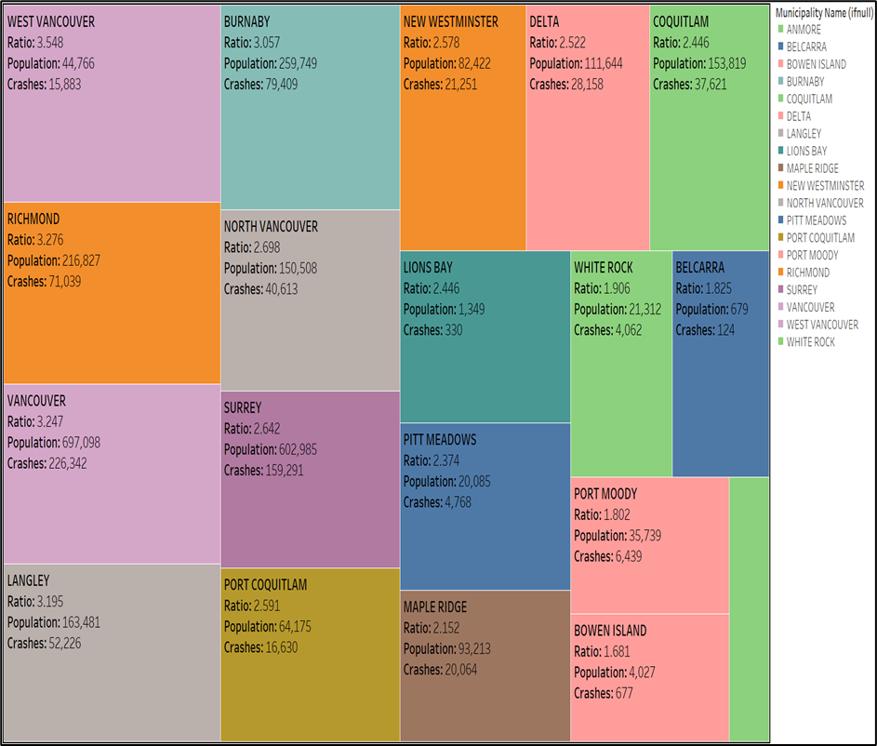
Crash Rates Per Capita Analysis
Tree map visualization displays crash-to-population ratios for Metro Vancouver municipalities.
West Vancouver: Ratio of 3.55 indicates around 4 car accidents for every 10 persons.
Burnaby: Ratio of 3.06 implies approximately 3 car accidents per 10 persons.
Richmond: Ratio of 3.28 suggests about 3 car accidents per 10 persons.
North Vancouver: Ratio of 2.70 signifies roughly 3 car accidents per 10 persons.
Burnaby, Richmond, and West Vancouver exhibit higher ratios compared to North Vancouver, indicating higher car accident frequencies per capita.
West Vancouver has the highest ratio, suggesting comparatively higher risk of car accidents for its population.

Slide 15
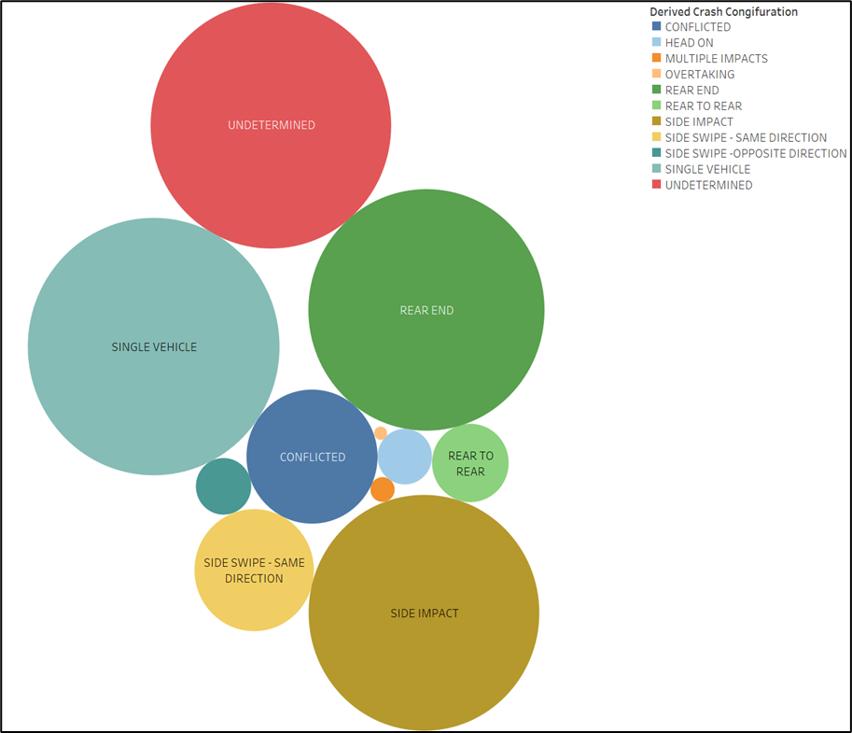
Types of Crashes Analysis
"Derived Crash Type" visualization categorizes crash configurations, highlighting single-vehicle accidents, rear-end collisions, and side impacts.
Insights:
Single-Vehicle Accidents: Common, indicating issues like loss of control or driver error.
Rear-End Collisions: Likely due to tailgating or distracted driving.
Side Impacts: Often result from failure to yield or improper lane changes.
Understanding each crash type enables targeted strategies for enhancing road safety by ICBC.

Slide 16
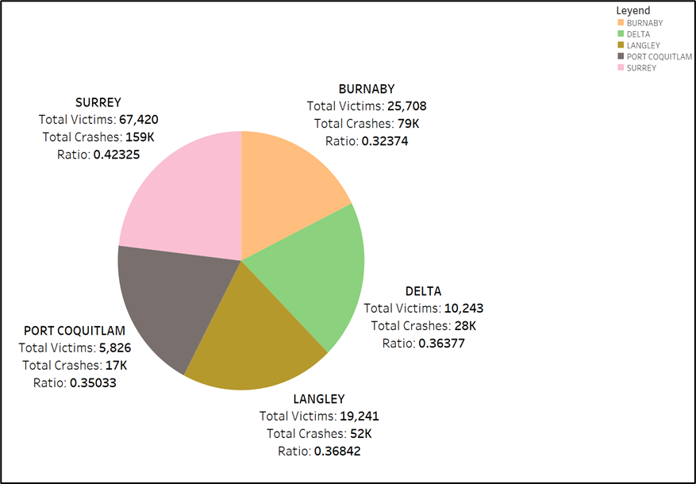
Vehicle and Victim Analysis
Matrix visualization breaks down crash factors into scenarios.
No Involvement: 723,925 crashes.
Animals: 3,336 crashes.
Heavy Vehicles: 40,487 crashes.
Cyclists: 7,973 crashes.
Pedestrians: 9,959 crashes.
Provides insights into crash involvement.
Effective communication of crash scenarios.

Slide 17
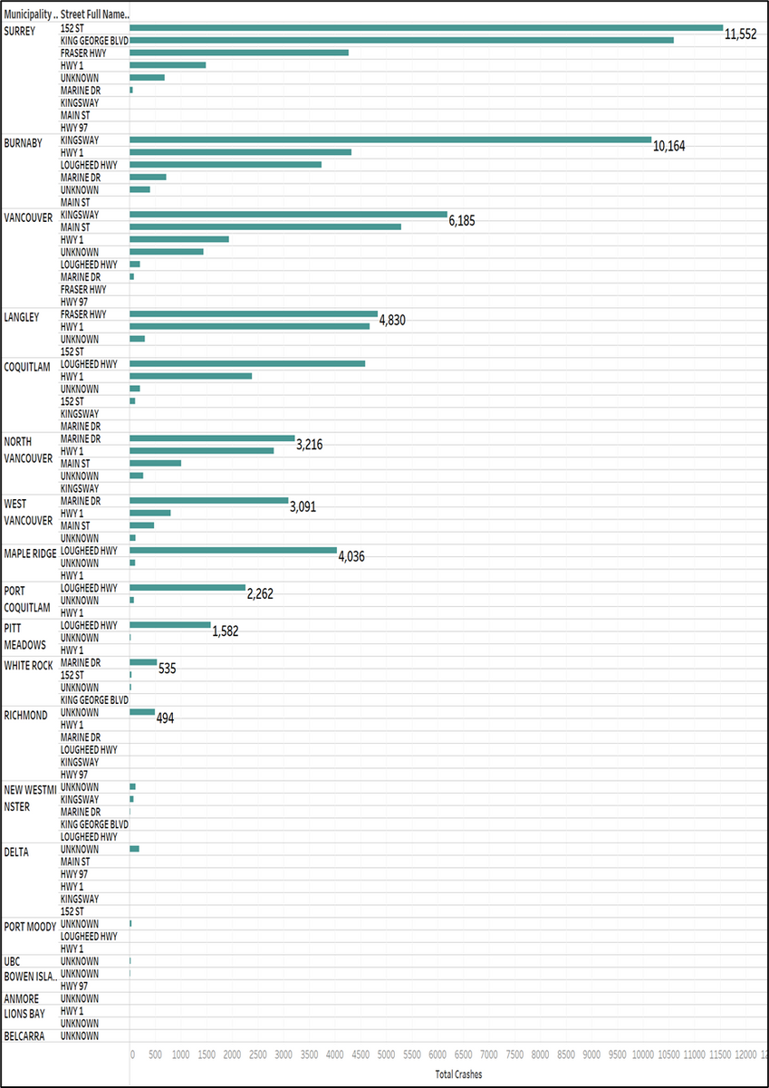
Street Analysis
Bar chart lists top streets with highest crash counts per city.
Insights:
Surrey and Burnaby streets have most crashes, indicating potential high traffic or safety issues.
Kingsway appears in both Burnaby and Vancouver, suggesting consistent high crash rates.
Langley and Coquitlam streets feature in top five, indicating crashes beyond urban centers.
Specific streets in each city may need further safety measures or road improvements.
Visualization aids authorities in identifying patterns and prioritizing interventions for road safety.

Slide 18
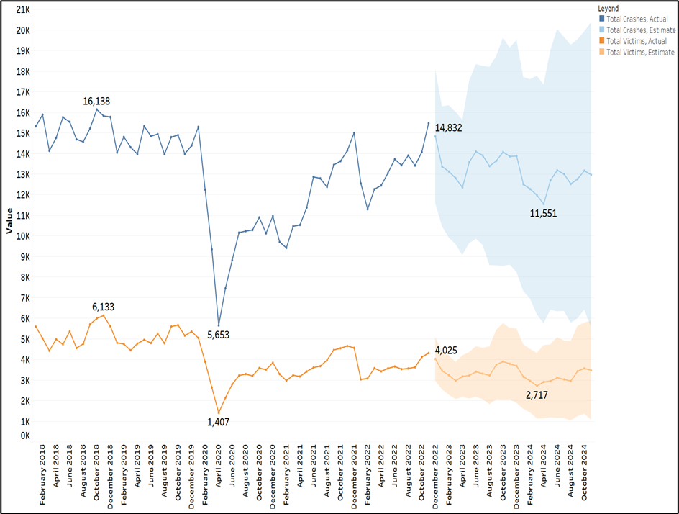
Crashes and Victims Forecast Analysis
Total Victims Forecast:
-Anticipates fluctuations over two years.
-Peak: December 2022 with 4,025 victims, declining to 2,717 in March 2024.
-Indicates non-linear decrease influenced by trends and seasons.
Total Crashes Forecast:
-Forecasts changes over two years.
-Peak: December 2022 with 14,832 crashes, decreasing to 11,551 in April 2024.
-Suggests non-linear decrease influenced by trends and seasons.
Both highlight complex patterns influenced by trends and seasons.
Understanding crucial for effective safety strategies.

Slide 19

Time Series Analysis: Stable behavior with a notable drop in early 2020 due to Covid-19
01
Conclusions
Geospatial Analysis: Vancouver, Surrey, and Burnaby exhibit highest crash counts.
02
Correlation Analysis: Positive correlation between population and crashes observed.
03
Crash Rates Per Capita: West Vancouver, Richmond, and Vancouver have highest crash ratios per inhabitant, with West Vancouver notable despite low population.
04

Slide 20
Crash Severity Analysis: Surrey, Langley, and Delta have highest crash victim counts.
05
Conclusions
Street Analysis: Streets with most crashes include 152 St (Surrey), King George Blvd (Surrey), Kingsway (Burnaby), and Main St (Vancouver).
06
Results suggest significant need for improved road safety policies, particularly in municipalities with high crash ratios per inhabitant and high victim rates like West Vancouver, Richmond, Vancouver, Surrey, Langley, and Delta. Focusing on streets with highest crash counts is crucial.
07
04

Slide 21
References:
ICBC. (2023, April 1). ICBC Reported Crashes. ICBC. https://www.icbc.com/about-icbc/newsroom/Statistics
Province of British Columbia. (2024, February 26). Population estimates. Province of British Columbia. https://www2.gov.bc.ca/gov/content/data/statistics/people-population-community/population/population-estimates

Slide 22





THANK YOU!
Jose Cornelio
Student ID: 300382456
+672-968-1990
Vancouver, Canada

